Slide 1

A Trail of Breadcrumbs -
Virgin Atlantic Airways’ Journey Towards Agility
Nic Whittaker, Head of Platform Engineering & DevOps
Michelle Moss, Technical Release & Delivery Manager
June 2020

Slide 2
About Virgin Atlantic **All facts, figures & structures are pre Covid, 2018/2019
What we do?
Hello Gorgeous – it doesn’t matter to us if you’re flying on a budget or in Upper – we will make you feel the most loved
We’ll do it with Virgin Flair, whoever you are and wherever you are going
Flights & Cargo to > 30 destinations
Holiday packages
Revenue/Turnover
Before Covid 2018 reported 5.8% year on year increase to £2.8 billion, 4.8% increase in passenger numbers
Post Covid – no passengers but our busiest Cargo on record!
Employees
We were around 9,000, sadly now facing reductions and furlough
CIO > VP Transformation > HO Platform/DevOps > Tech Release & Deployment, QA, Dev & DevOps

Slide 3
What?
This isn’t a talk about…
how we've got it nailed
tools
the right way
This is a talk about what to do when…
you've been told to fix the un-fixable
you don't know where to start
what you're doing doesn't seem to be working
Force Majeure
Notes:
NW – this isn’t
MM – this is

Slide 4

How our agile journey started…
"We need some DevOps".
"(You will be) accountable for developing and operating world class next generation platforms that will meet or exceed the expectations of next generation of digital savvy, mobile first customers…(and) lead a DevOps team at scale”
“What’s that? No, there's no dedicated funding or resource, just use what you've got"
#DONT PANIC
Notes:
Nic to set challenge

Slide 5

1 First Breadcrumb
Why were we really having the DevOps conversation?
Technology

Slide 6

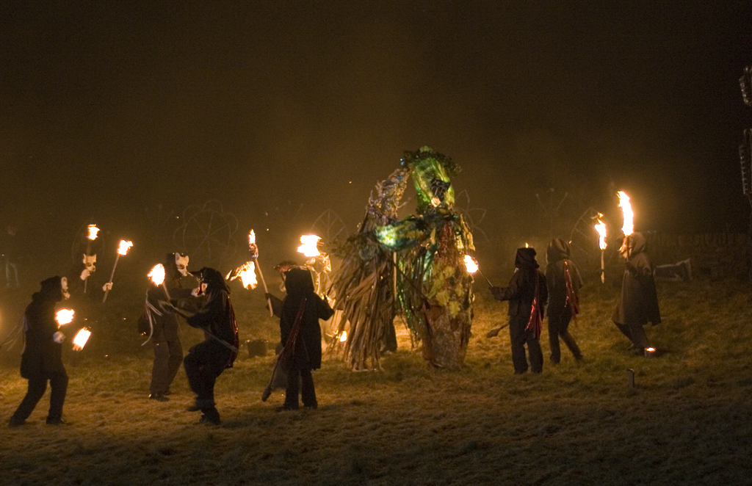
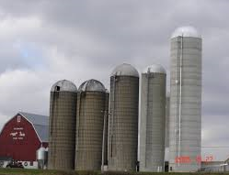

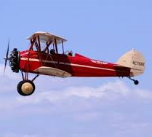
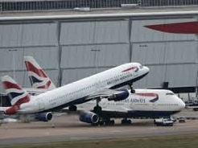
What was the problem?

Slide 7

2 Second Breadcrumb
What did we need to do?

Slide 8
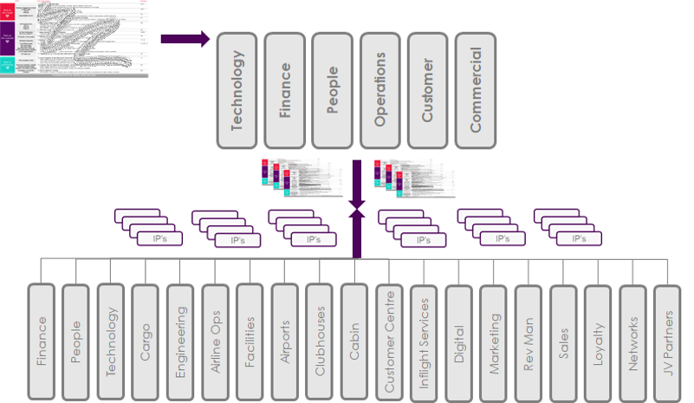
Old Ways of Working
Silos and Demand vs ability
Fake agile, paper qualifications, doing waterfall
High cost, long running projects – delivering…something
Day#1 “packs” & nice pictures
Contractors and knowledge
No single governance “truth”
Heavy with suppliers
Reinventing the wheel, no central control

Slide 9
What might help fix the problem?
“Give me some Black Box DevOps”
“agility”
Lean
“Speed”
DevOps isn’t just CICD
It’s collaborative behaviours across the whole organization
But SO WHAT? These are all “things you do” because…

Slide 10
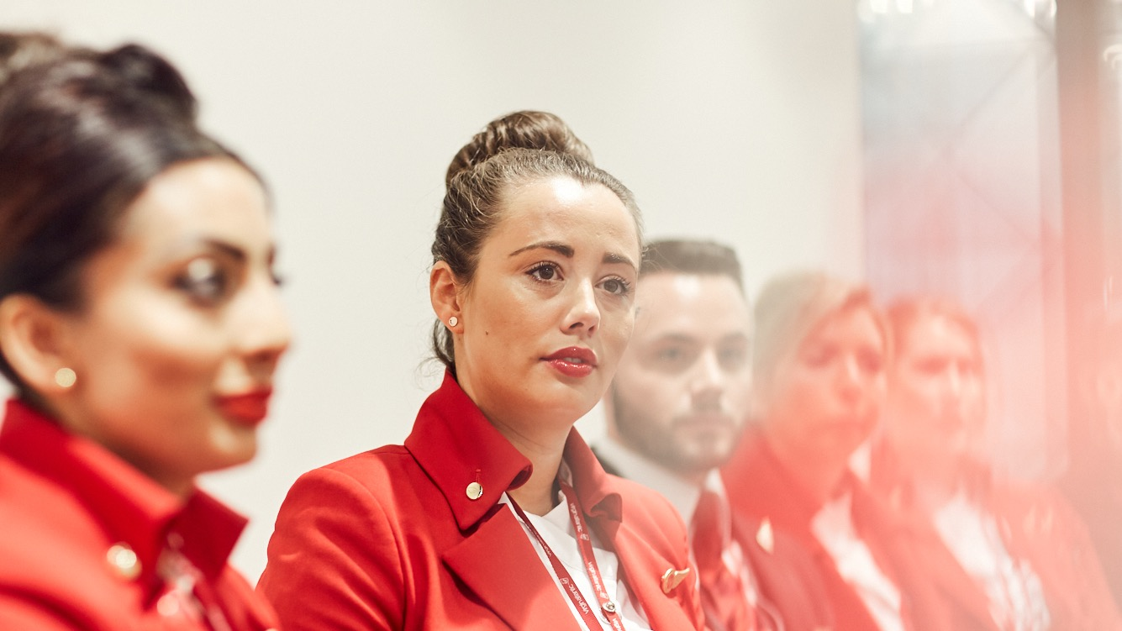
3 Third Breadcrumb
What did we have to work with?
People

Slide 11
What did we have to work with?
Looked at how others were doing it.
Suppliers versus Delivery Partners?
Negotiate with a supplier?
Move a project cost around?
Repurpose a training budget?

Slide 12

4 Fourth Breadcrumb
Just start…
People

Slide 13
Where were the opportunities?
We had no money, a sketchy mandate and no top-down buy in.
Start!
Turns out we had one “agile” project already running – so we started here and then grew…
Data, APIs, “SCV”, Mobility….
Began working up
Maturity reviews…
Workshops…
Value stream mappings…

Slide 14
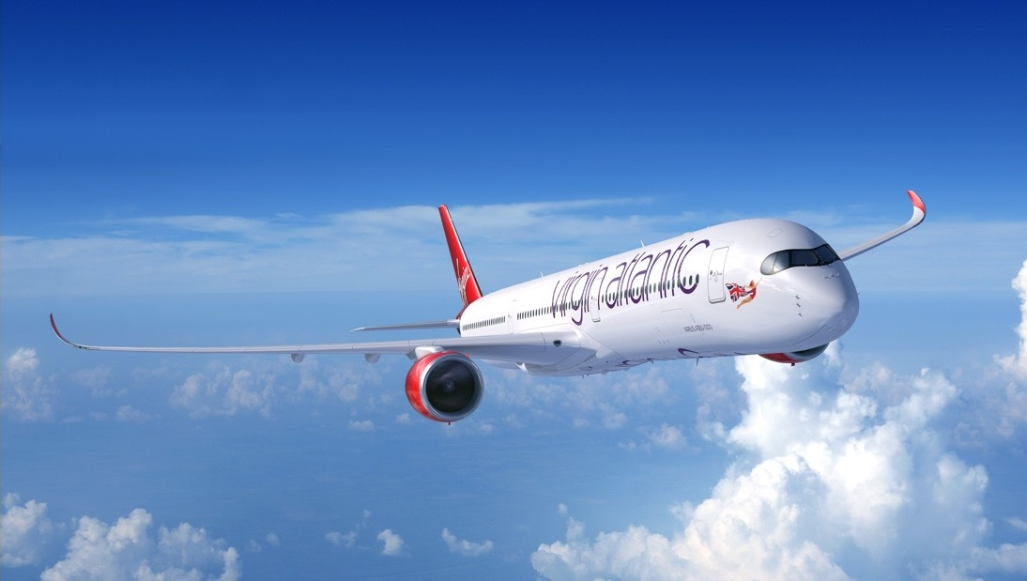
5 Fifth Breadcrumb
Take off!
But…how do we generate Thrust?!
"A year from now you will wish you had started today"

Slide 15
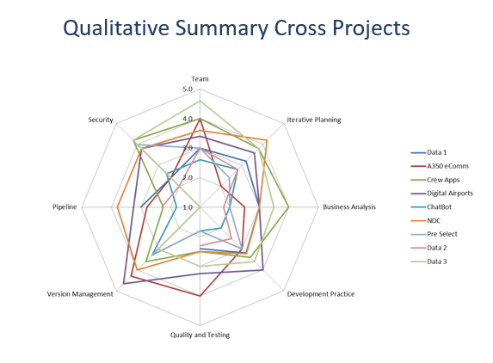
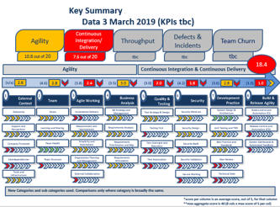
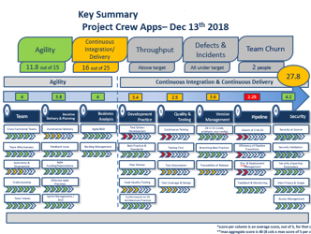
Driving progress thru’ ownership
How can you drive take-up and improvement?
Capability measures?
Are you changing the right stuff? Lean
Teams own their values
People first, tools second
"High Trust, Low Blame”, empowered teams

Slide 16
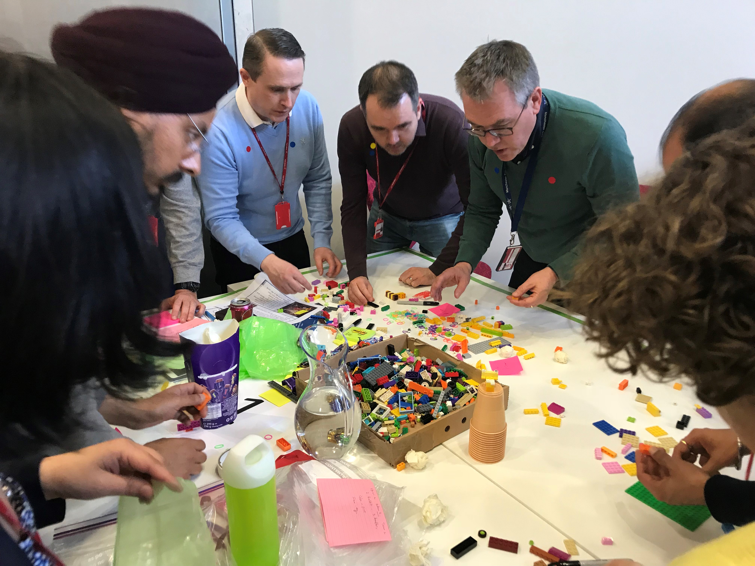

Fostering engagement
People engagement – even the naysayers!
Workshops & 101s
Accrued resources to help drive the work forward
Get Security onboard
Build Communities

Slide 17

6 Sixth Breadcrumb
Problems, Problems…
Customer

Slide 18

The problems start mounting up…
“Boss – the Army of the Dead are massing at the Giant Ice Wall…”
“It's not fast enough - I'm off outside the tent“
“I’d love to, but look at our workload”
“What do you mean, there’s a licence cost?”
Rooms! Infrastructure!
Legacy process!
“Boss – I’ve been offered a job in the Army of the Dead”
The key attribute to achieve change is resilience
HBO

Slide 19
But we had made real progress…
Offshore – Team Delhi & Team Crawley
Established “Core platform teams” - Cloud Ops + Shift Left
XLR8 Dojo - optimise, collaborate, opportunities for best common outcome
Alignment on tooling
Increase process and testing automation
Improvement owned by teams
“Champions” & Communities

Slide 20
Hold on a sec…why were we bothering again?
Those who “got it” understood we needed to pivot towards
Products on Platforms
built and run by Core Capability teams
&
Value and Outcome based thinking

Slide 21

7 Seventh Breadcrumb
Ding ding! All change at the C Suite!
JV

Slide 22
Changes in Leadership and Organisation
In six years, several changes in the senior leadership
Inevitable reorganisations follow
Do reorganisations fix your delivery challenges?
So – where did the new leadership want to go next?

Slide 23
Why?
We want to be the Most Loved travel company.
How?
A Change Delivery Framework that ensures
we
Do the basics well
Deliver the right things at the right time, generating value as early as we can,
Wither the things that no longer support the Why
Are amazing partners within our ecosystem
What?
Lean Portfolio
Run teams with agility
Use continuous Lean improvement
Achieve true DevOps
constant collaborations
automating the repeatable
driving quality
Empowered teams
technology

Slide 24
The Next Steps….
We knew how to get the basics right, repeatably
We wanted capabilities not silos, reducing divergence & waste
We needed a single demand funnel, agreed & reviewed at organisational level
We were discussing value streams and portfolio increments
We were approaching a mindset change at organisational level

Slide 25

8 Eighth Breadcrumb - New Ways of Working
What you can do with top down buy-in.
The top-down meets the bottom-up.
And..."I never thought it would work - you've changed my mind"!
JV

Slide 26
Big Cultural Shift (Learnings)
Establish core Value Streams, owned by Exec Sponsors (starter for ten)
Everything scored against the “Why?”
Visibility across all streams & dependencies & risk & cost
Representation for all points in the value chain
Quarterly planning cycle
ePMO brought near the deliveries, creating Single Source of Truth for Change
Establish the evident
Proffer a well-evidenced model
Offer a route to deal with contention
Mandate a single entry funnel
Dashboard real-time
Film them doing it
Loop

Slide 27
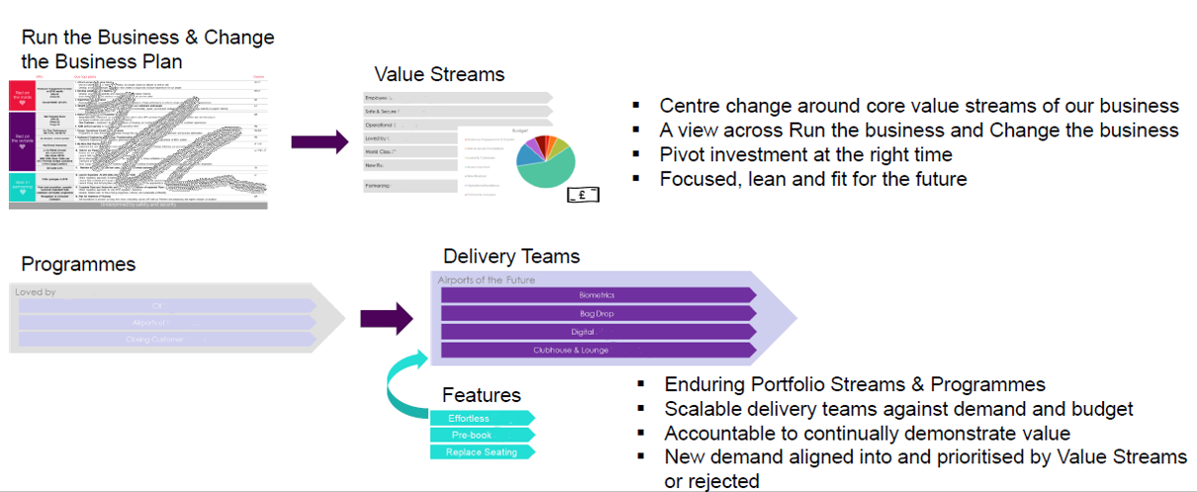
New Ways of Working

Slide 28
PI #1
Embed video

Slide 29
Outcomes (& Success…?)
**All figures Pre Covid
We went in with an “MVP”. Did we meet it?
✓
It is happening and we all understand our roles and our collective accountability
We all understand the challenge ahead of us: £51m of demand £35m budget and flat headcount**
We commit to do this together. Individually we may go faster but together we will go further.
“I never thought it would work – you’ve changed my mind!”
✓
PI1
✓
✓ ✓ ✓

Slide 30

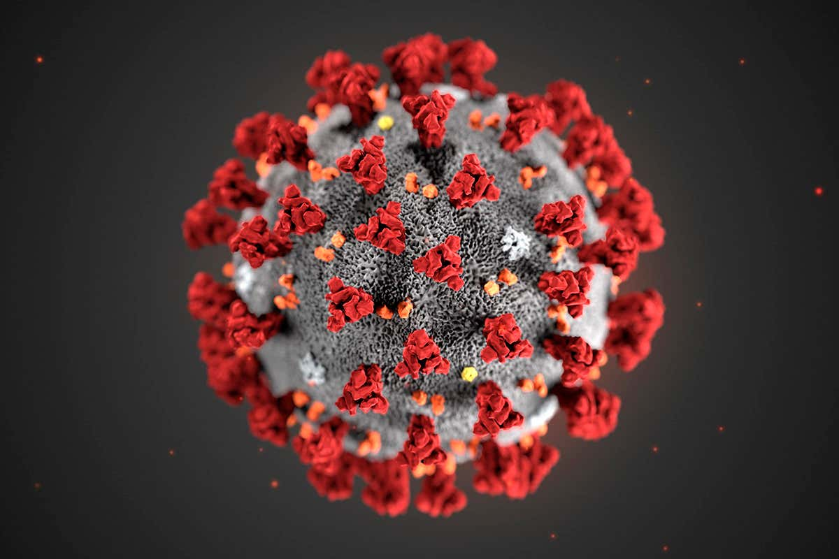
9 Coda – Out of Breadcrumbs
Just when you think you’re finally motoring...

Slide 31

Covid…
Challenges
People
Rapid adaption
Getting Ready for Take Off in 2021
“Progressive companies that improve operational efficiency and invest for the future are more likely to out-perform their competition during recovery”*
Obstacles & Help Needed
Staff reductions & Portfolio funding reductions – buy tickets and holidays!
More focus on the core infrastructure teams - underway
Revising and improving the Value Streams – not yet addressed
*Source: Roaring Out of Recession by Ranjay Gulati , Nitin Nohria and Franz Wohlgezogen, HBR March 2010

Slide 32
“Every success story is a tale of constant adaption, revision and change. A company that stands still will soon be forgotten”

